Slide 1
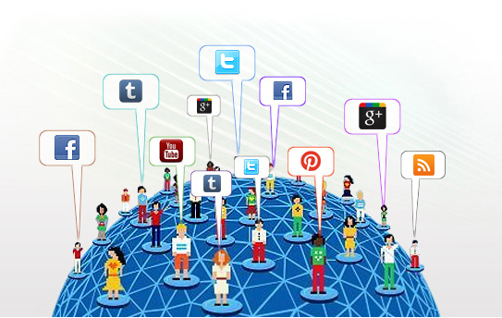
Unsupervised Sentiment Analysis for Social Media Images
Yilin Wang¹ Suhang Wang¹
Jiliang Tang² Huan Liu¹ Baoxin Li¹
¹Arizona State University
²@Yahoo Research San Jose
IJCAI 2015 Buenos Aires

Slide 2
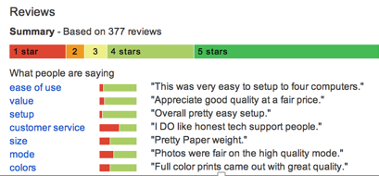
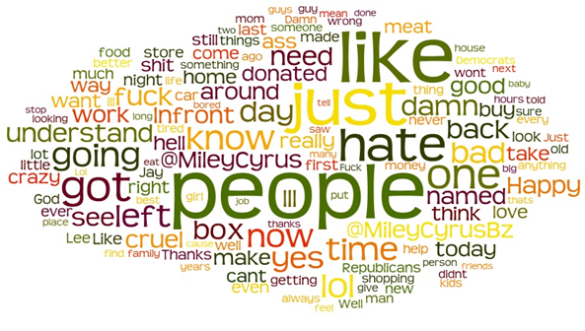
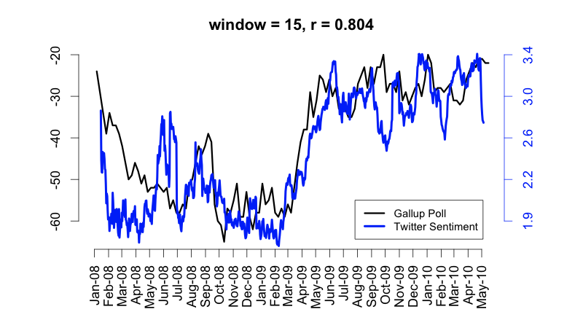
Motivation
Brendan O'Connor, et al. From Tweets to Polls: Linking Text Sentiment to Public Opinion Time Series. In ICWSM-2010
Notes:
Sentiment analysis is an important and hot research area in recent years, it aim to study whether given a piece of text is positive negative or neutral? A text can be tweets ,, a custom review, a document and so on so forth.
There are many important applications for sentiment analysis.
The first example is from recommendation system it shows the sentiment towards aspect of the product.
Another example is using sentiment to prediction demography. This figure shows how sentiment correlate to consumer confident from 2008 to 2010. Such that it shows the importance of sentiment towards marketing.

Slide 3
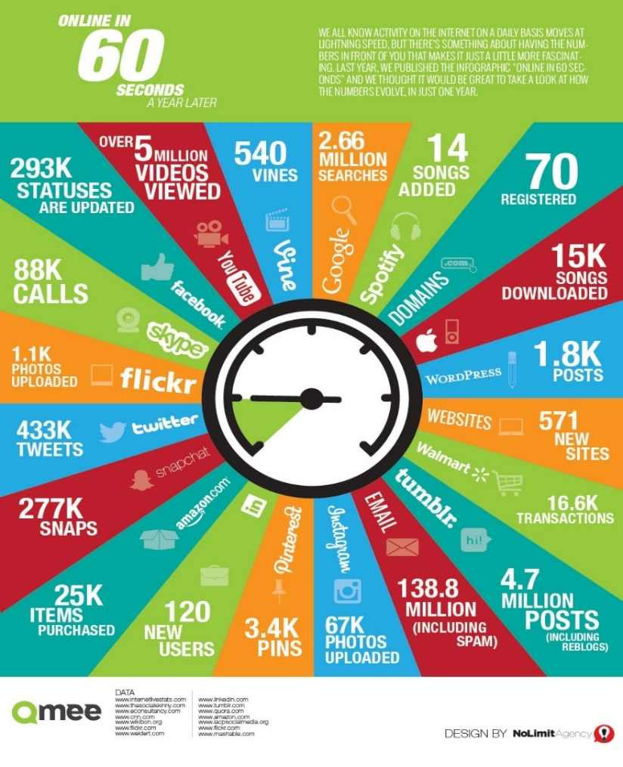

Why Sentiment Analysis for Social Media Images ?
Highlight the content
Instagram | 67K Images Upload
SnapChat (2013) | 104 K Images Shared
Tumblr (2013) | 20 K Image Upload
Twitter | 36% of tweets contain photo. 433K tweets ~ 155K
Notes:
Since the text based sentiment has been well studied, the image centric sentiment analysis receives less attention.
Thus we
This is an interesting research called “what happened in 60s during 2014 on the internet”. Here I have highlighted some important numbers.
Thus, understanding visual sentiment may in turn benefit or even enable many real-world applications such as
advertisement, recommendation, marketing and health-care.

Slide 4
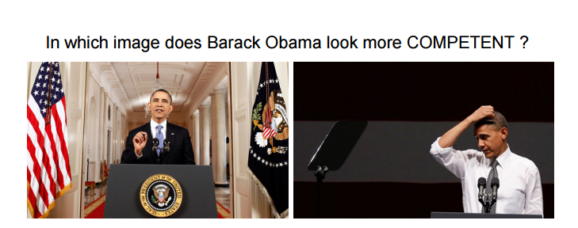



Applications
Emotion wellness , personalized recommendation
Notes:
Let’s see some examples. First we know a picture can tells a story, a picture is worth a thousand words. Thus one application could be visual persuasion.
Persuasion is a core function of communication, aimed at influencing audience beliefs, desires, and actions.
On the right side, which picture will Obama use to get more support from voters? I think the Obama will never use the right photo which shows his has some troubles. Also, monitor the image data from social media sites will help one to improve his self esteem and resilience. Allowing them to bounce back with ease, from poor emotional health, and physical stress and difficulty

Slide 5
Existing Approaches are Purely Supervised..
Sentiment labels are in general unavailable for social media images, and it is too labor- and time-intensive to obtain labeled sets large enough for robust training.
Thumbs up? Sentiment classification using machine learning techniques. [Pang et al 2002]
Sentiment analysis and opinion mining [Liu et al 2012]
Listening to the crowd: automated analysis of events via aggregated twitter sentiment. [Hu et al 2012]
Text based
Sentiment Analysis
Can we understand Van Gogh’s mood?: learning to infer affects from images in social networks.[Jia et all 2012 ]
Sentribute: image sentiment analysis from a mid-level perspective. [Yuan et al2013]
Large-scale visual sentiment ontology and detectors using adjective noun pairs [Borth et al2013]
Robust image sentiment analysis using progressively trained and domain transferred deep networks. [You et al 2015]
Image based
Sentiment Analysis

Slide 6


Need for Combining Text & Visual Cues
Face
Detector
Expression recognition
“Cry”
Expression recognition
Face
Detector
“Cry”
Visual Affective Gap
Notes:
However, understanding the visual sentiment is inherently challenge.
For example, consider these two figures : one can easily detect the crying lady and girl (using computer
vision algorithms. However, the same “crying” action conveys two clearly different
sentiments: the “crying” in Figure 1a is obviously positive as the result of a successful marriage proposal. In contrast, the
tearful girl in Figure 1b looks quite unhappy thus expresses negative sentiment.
In other words, the so-called “semantic affective gap” exists between rudimentary visual features and human sentiment embedded in a photo. On the other hand, one may also consider inferring the sentiment of a photo via its textual descriptions (e.g., titles) using existing off-the-shelf text-based sentiment analysis tools Although these descriptions can provide very helpful context information of the photos, solely relying on them while ignoring the visual features of the photos can lead to poor performance as well

Slide 7
Need for Combining Text & Visual Cues
“My cute baby wants ice cream!”.
“Girlfriend crying a lot when I proposed to her”.
Notes:
However, understanding the visual sentiment is inherently challenge.
For example, consider these two figures : one can easily detect the crying lady and girl (using computer
vision algorithms. However, the same “crying” action conveys two clearly different
sentiments: the “crying” in Figure 1a is obviously positive as the result of a successful marriage proposal. In contrast, the
tearful girl in Figure 1b looks quite unhappy thus expresses negative sentiment.
In other words, the so-called “visual affective gap” exists between rudimentary visual features and human sentiment embedded in a photo. On the other hand, one may also consider inferring the sentiment of a photo via its textual descriptions (e.g., titles) using existing off-the-shelf text-based sentiment analysis tools Although these descriptions can provide very helpful context information of the photos, solely relying on them while ignoring the visual features of the photos can lead to poor performance as well. Consider Figure 1 again: by analyzing only the text description, we can conclude that both Figure 1a and 1b convey negative sentiment as the keyword “crying”

Slide 8

Outline
Motivation and Related Work
Unsupervised Sentiment Analysis
Overview
Nonnegative Matrix Factorization
Learning Process with Regularization
Evaluation and Experiments
Conclusion and Future Work

Slide 9
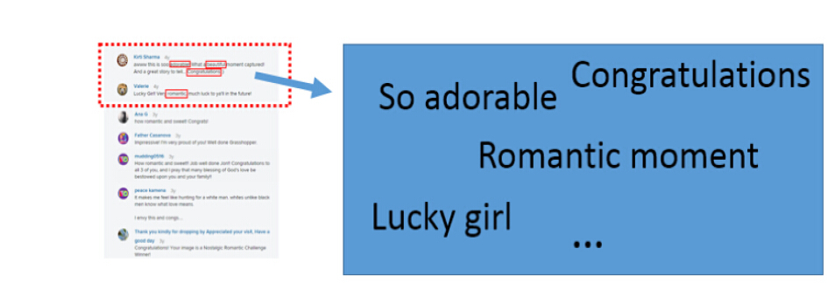




Overview of USEA: Our Hybrid Approach
Model
Learning
Visual
Feature
Prior Knowledge
Notes:
The weaknesses discussed in the foregoing motivate the need for a more accurate automated framework to infer the
sentiment of photos, with 1) considering the photo context to bridge the “visual affective gap”, 2) considering a photo’s visual features to augment text-based sentiment, and 3)

Slide 10
Sentiment Analysis via matrix Factorization
Text Term
Data
Sentiment
Visual feature
Sentiment
Text Term
Text feature
Sentiment
Data
Data
Correlation between image and text
Sentiment
Data
Data
Visual feature
Sentiment
Visual Feature

Slide 11
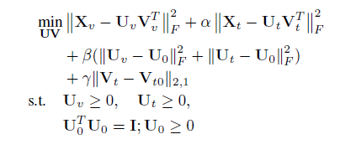
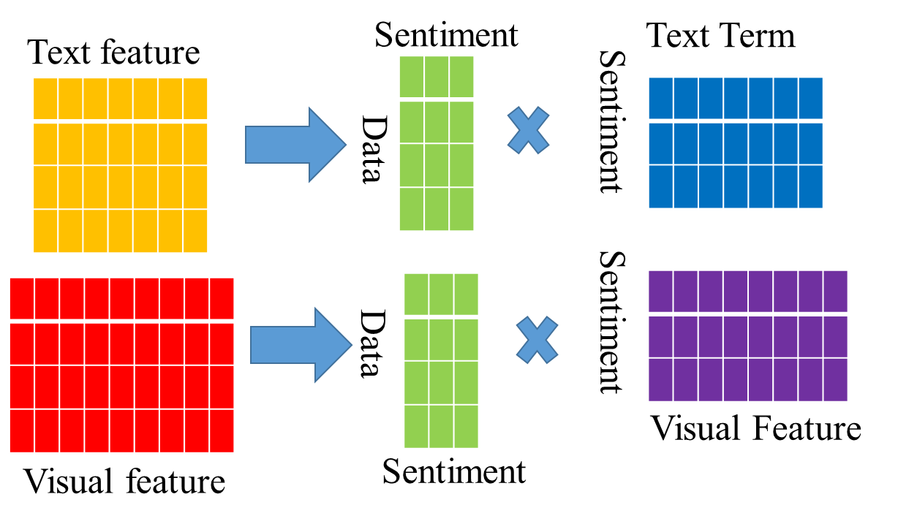
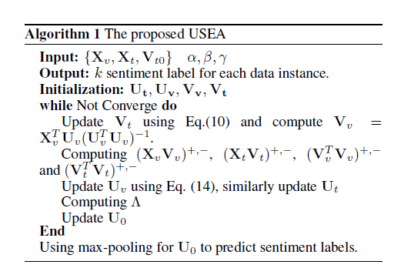

The Framework USEA (you see)
Sentiment signal MPQA
Correctness analysis
Convergence analysis
Theorem 1-4
$$U_{0}$$

Slide 12
Outline
Motivation and Related Work
Visual Sentiment Analysis with Social Cues
Experiments and Evaluation
Experiment setting
External comparison
Internal comparison
Conclusion and Future Work

Slide 13
Experimental Setting
Dataset
20000 Flickr -> manually label
~100K Flickr -> tag labeled
~130k Instagram -> tag labeled
Comparison
Sentiment prediction
Parameter Analysis

Slide 14
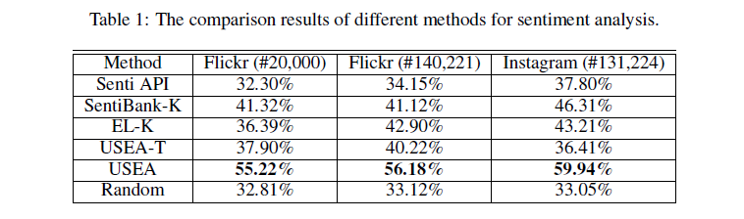
Comparing USEA to Text-based and Image-Based Approaches
Text based
Image based
Our
approach

Slide 15
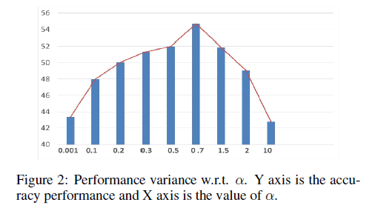
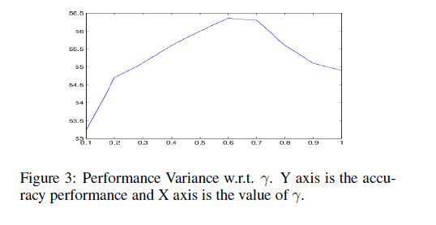
Parameter Analysis

Slide 16
Conclusion and Future Work
We formally define the problem of sentiment analysis in unsupervised fashion as far as we know there is no existing work.
By leveraging the cross modality information, we bridging the affective gaps for social media images.
We proposed matrix factorization framework to model the heterogeneous feature spaces.
Social Cues likes contextual information, spatial-temporal patterns could be potentially useful to measure the sentiment in future exploration.
We can further explore how sentiments diffuse in the social network and how people's sentiments correlate with internal (their friends) and external (public events) factors.

